Slide 1


Noida Institute of Engineering and Technology, Greater Noida
Logic and Argumentation
Unit: 5
Subject: DESIGN THINKING I
Dr. Pratibha Pandey
Mr. Pitamber Adhikari
Course Details B Tech 1st Sem

Slide 2
Content
The argument, claim, and statement
Identifying premises and conclusion
Truth and logic conditions
Valid/invalid arguments
strong/weak arguments
Deductive argument
Argument diagrams
Logical reasoning
Scientific reasoning
Logical fallacies
Propositional logic
Probability and judgement
Obstacles to critical thinking

Slide 3
Course Objective
The objective of this course is to familiarize students with design thinking process as a tool for breakthrough innovation. It aims to equip students with design thinking skills and ignite the minds to create innovative ideas, develop solutions for real-time problems.

Slide 4
Course Outcome
After completion of this course, students will be able to-
CO1: Develop a strong understanding of the design process and apply it in a variety of business settings
CO2: Analyze self, culture, teamwork to work in a multidisciplinary environment and exhibit empathetic behavior
CO3: Formulate specific problem statements of real time issues and generate innovative ideas using design tools
CO4: Apply critical thinking skills in order to arrive at the root cause from a set of likely causes
CO5: Demonstrate an enhanced ability to apply design thinking skills for evaluation of claims and arguments

Slide 5
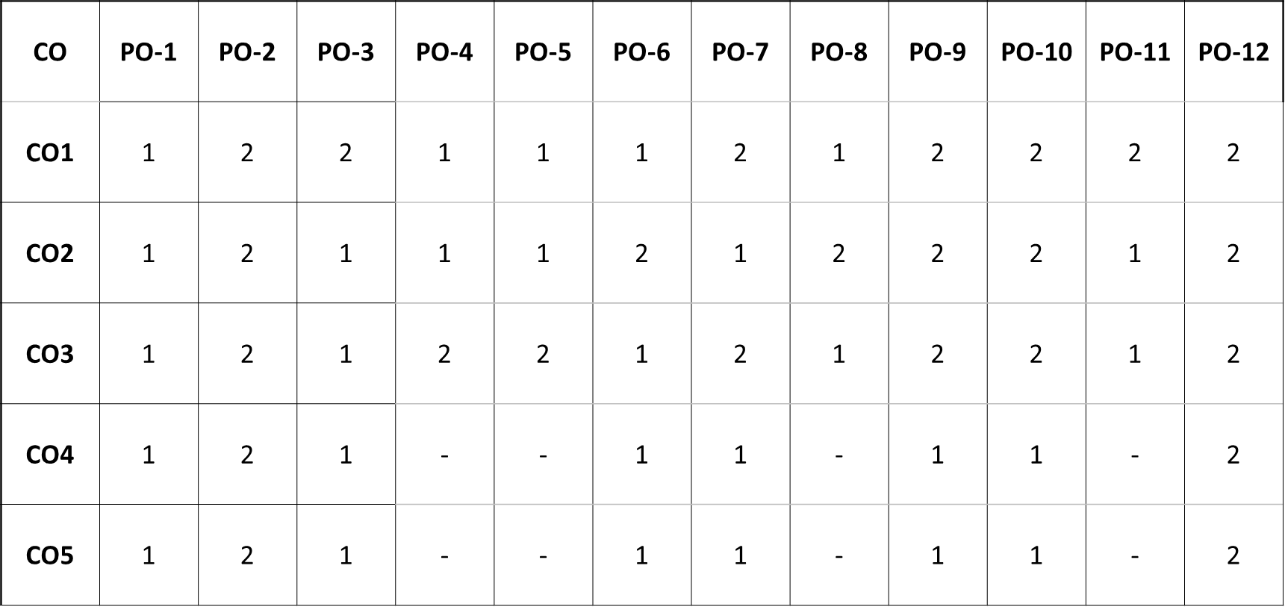
CO-PO and PSO Mapping

Slide 6
Prerequisite and Recap
Prerequisite:
Student should have basic understanding of critical thinking, difference between critical and ordinary thinking as well as five pillars of critical thinking.
Recap:
Revision of topics like fundamentals of critical thinking and critical thinking skills.

Slide 7
Argument, Claim, and Statement [CO5]
Topic Objective:
Helps in systematic evaluation or formulation of beliefs, or statements, by rational standards.
Recap:
Discussion about critical thinking.

Slide 8
Argument, Claim, and Statement [CO5]
An argument is often taken to be a somewhat heated dispute between people. But in logic and critical thinking, an argument is a list of statements, one of which is the conclusion and the others are the premises or assumptions of the argument.
The ability to construct, identify, and evaluate arguments is a crucial part of critical thinking. Giving good arguments helps us convince other people, and improve our presentation and debating skills.
A claim is an assertion about the truth, existence, or value of something that is either true or false. Claims are also called statements or propositions. When supported by premises, a claim becomes a conclusion.

Slide 9
Argument [CO5]
What is an argument?
An argument is a set of statements made up, at minimum, of the following parts:
A main conclusion: This statement is a claim that expresses what the arguer is trying to persuade us to accept, whether or not it actually is true.
Evidence:
Also known as premises or support, the arguer provides these statements in order to show us that the conclusion is true.
Essentially, the evidence answers the question, “Why do you believe [the conclusion] to be true?”
The simplest arguments on the LSAT have just one piece of evidence; more complex arguments will have several.

Slide 10
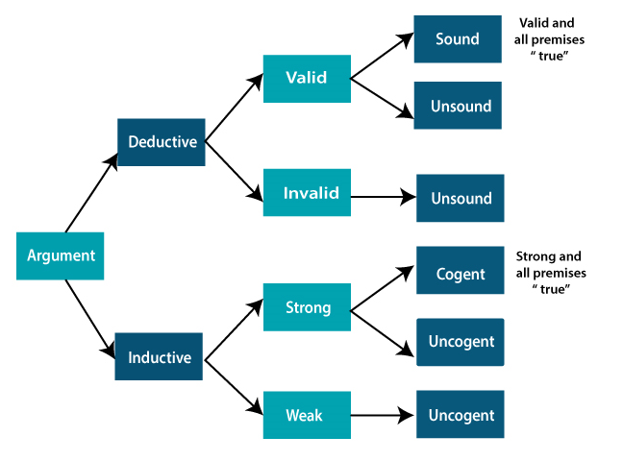
Argument [CO5]

Slide 11
Identifying Premises and Conclusion [CO5]
A premise includes the reasons and evidence behind a conclusion. A conclusion is the statement that the premise supports and is a way of promoting a certain belief or point of view.
An argument is a group of statements including one or more premises and one and only one conclusion.
A statement is a sentence that is either true or false, such as "The cat is on the mat." Many sentences are not statements, such as "Close the door, please" , "How old are you?"
A premise is a statement in an argument that provides reason or support for the conclusion. There can be one or many premises in a single argument.
A conclusion is a statement in an argument that indicates of what the arguer is trying to convince the reader/listener. What is the argument trying to prove? There can be only one conclusion in a single argument.

Slide 12
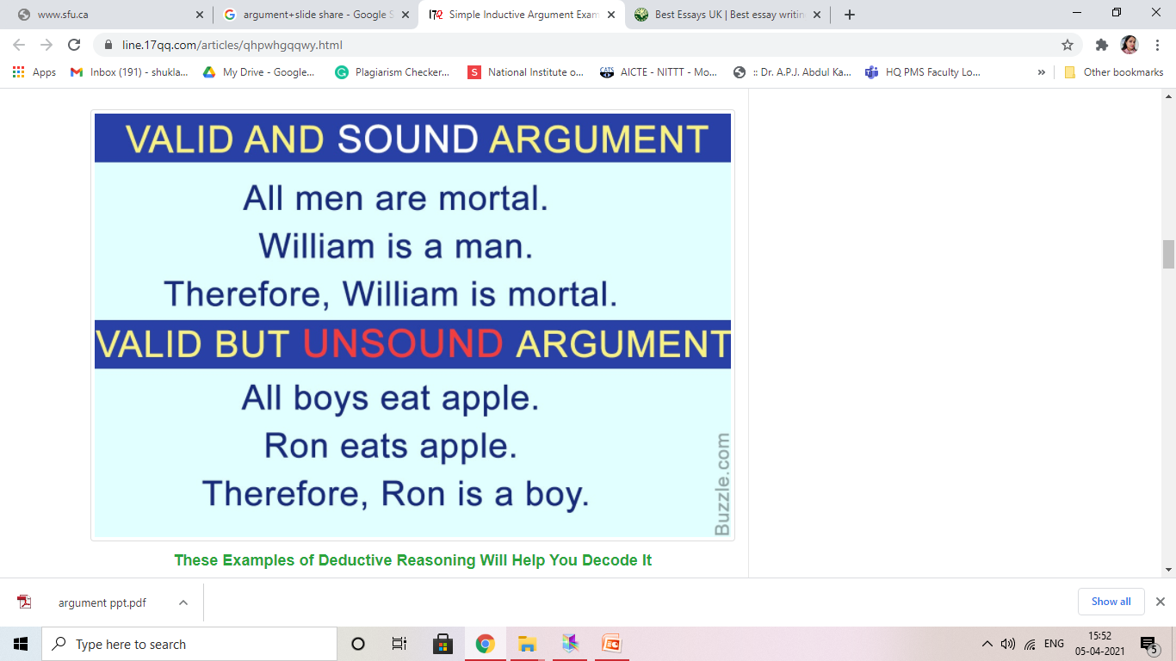
Truth and Logic Conditions [CO5]
A truth condition is the condition under which a sentence is true.
Truth conditions of a sentence don't necessarily reflect current reality.
They are merely the conditions under which the statement would be true.

Slide 13
EXAMPLE
Truth and Logic Conditions [CO5]
Cats with long hair shed all over the house so you should not get a long-haired cat.
I have heard that they also have lots of fleas.
P¹ | Long-haired cats shed all over the house
P² | Long-haired cats have a lot of fleas
C | You should not get a long haired cat

Slide 14
Deductive Arguments [CO5]
A deductive argument is either valid or invalid. There is no in-between, no gray area.
The test for validity of a deductive argument is the following: If there is any possible way for an argument to have all true premises and a false conclusion, then the argument is invalid.
Again: to determine validity we are not concerned with whether the premises are actually true, that is a separate step. We will just pretend or assume that they are.
This is an important but sometimes difficult point to grasp. The most difficult task at this stage is to understand that an argument form can be valid, even if it has false premises and/or a false conclusion.
If a deductive argument is valid, then we go ahead and check the factual claim, because only then is it possible that the argument might be sound.
An invalid argument is always unsound. An argument is sound if it is valid and the premises are all actually true.

Slide 15
Deductive Arguments [CO5]
A deductive argument is an argument that is intended by the arguer to be deductively valid, that is, to provide a guarantee of the truth of the conclusion provided that the argument’s premises are true.
This point can be expressed also by saying that, in a deductive argument, the premises are intended to provide such strong support for the conclusion that, if the premises are true, then it would be impossible for the conclusion to be false.
An argument in which the premises do succeed in guaranteeing the conclusion is called a (deductively) valid argument.

Slide 16
Deductive Arguments [CO5]
An argument is a set of statements that consists of a conclusion and the statements said by the arguer to lead to that conclusion.
Premises are the statements that lead to the conclusion.
A deductive argument is an argument in which the arguer is maintaining that the premises show that the conclusion is necessarily true.
A deductive argument is said to be valid if the premises logically lead to the conclusion.
A deductive argument is said to be sound if it is valid and has true premises. The conclusion of a sound deductive argument is necessarily true.
A syllogism is a deductive argument with two premises. Here is one example of a syllogism that is valid and sound:
All human beings are mortal.
Socrates is a human being.
Thus, Socrates is mortal.

Slide 17
Deductive Arguments [CO5]
Now consider this syllogism:
All dogs are cats.
All cats are birds.
Thus, all dogs are birds.
This argument is valid, because the conclusions follows from the premises, but it is clearly not sound since the premises are false.
Of course, more complex deductive arguments may have more than two premises.
In many cases arguments are linked together. The conclusion of one argument becomes a premise for the next argument. In analyzing complex arguments, it is often important to break the argument down into its component parts.
In many cases parts of deductive arguments are missing. In order to critique an argument, it may be important to uncover the missing premises.

Slide 18
Inductive Argument [CO5]
On the inductive side of things we classify arguments as strong and weak.
This classification correlates loosely with the terms valid and invalid for deductive arguments, except that with inductive arguments there is gray area; there is an in-between. An inductive argument can be more or less strong, more or less weak.
Generally, if there is more than a 50-50 chance that the conclusion will follow from the (presumed) truth of the premises, then it is strong; otherwise it is weak.
In judging some types of inductive arguments you will be looking at sample size as scientists do when they are examining results of experiments. After all, they are engaged in exactly the same project that you are: "is the 'proof' strong enough to warrant a particular inference?"--They are judging inductive arguments too, albeit more complicated ones than yours.
Strong inductive argument with true premises is termed cogent. To say an argument is cogent is to say it is good, believable; there is good evidence that the conclusion is true.

Slide 19
Inductive Argument [CO5]
There are several key types of inductive reasoning:
Generalized — Draws a conclusion from a generalization. For example, “All the swans I have seen are white; therefore, all swans are probably white.”
Statistical — Draws a conclusion based on statistics. For example, “95 percent of swans are white” (an arbitrary figure, of course); “therefore, a randomly selected swan will probably be white.”
Sample — Draws a conclusion about one group based on a different, sample group. For example, “There are ten swans in this pond and all are white; therefore, the swans in my neighbor’s pond are probably also white.”
Analogous — Draws a conclusion based on shared properties of two groups. For example, “All Aylesbury ducks are white. Swans are similar to Aylesbury ducks. Therefore, all swans are probably white.”

Slide 20
Inductive Argument [CO5]
Predictive — Draws a conclusion based on a prediction made using a past sample. For example, “I visited this pond last year and all the swans were white. Therefore, when I visit again, all the swans will probably be white.”
Causal inference — Draws a conclusion based on a causal connection. For example, “All the swans in this pond are white. I just saw a white bird in the pond. The bird was probably a swan.”

Slide 21
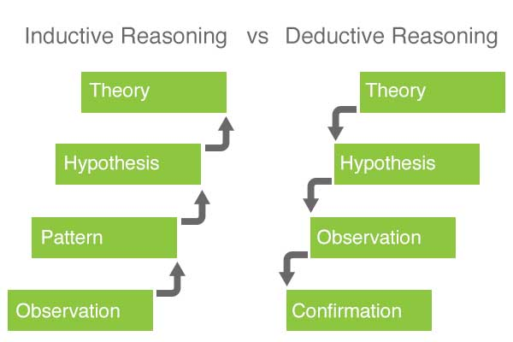
Inductive vs Deductive Arguments [CO5]

Slide 22
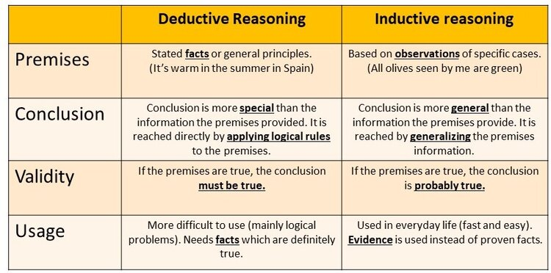
Inductive vs Deductive Arguments [CO5]

Slide 23
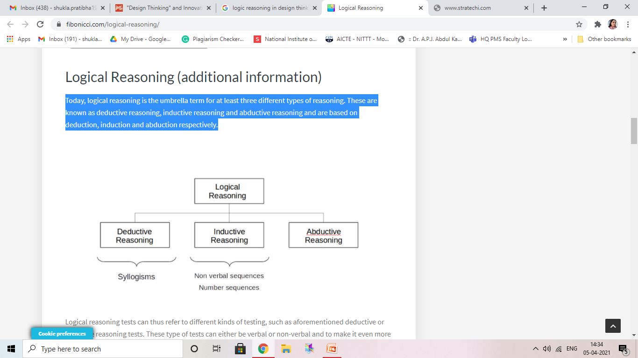
Logic Reasoning [CO5]
Logical reasoning is the umbrella term for at least three different types of reasoning. These are known as deductive reasoning, inductive reasoning and abductive reasoning and are based on deduction, induction and abduction respectively.

Slide 24
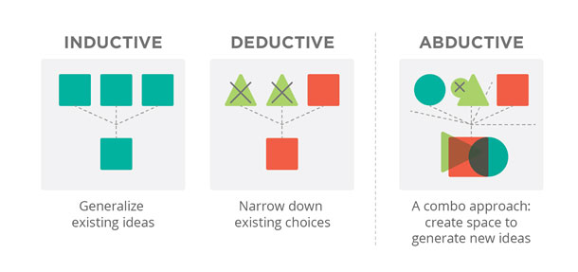
Logic Reasoning [CO5]

Slide 25
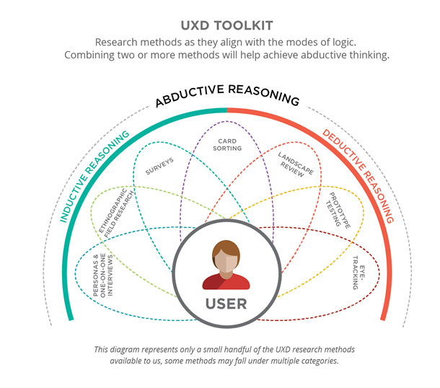
Logic Reasoning [CO5]

Slide 26
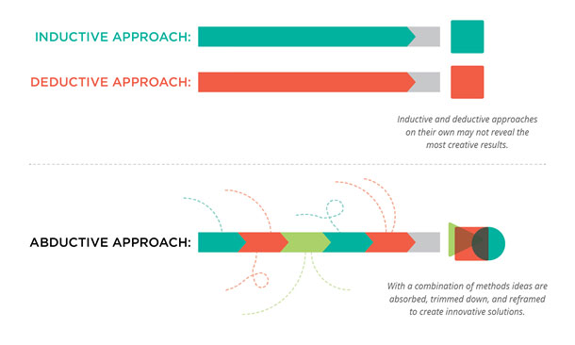
Logic Reasoning [CO5]

Slide 27
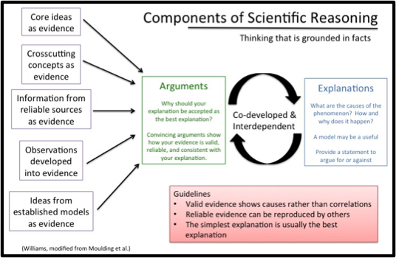
Scientific Reasoning [CO5]

Slide 28
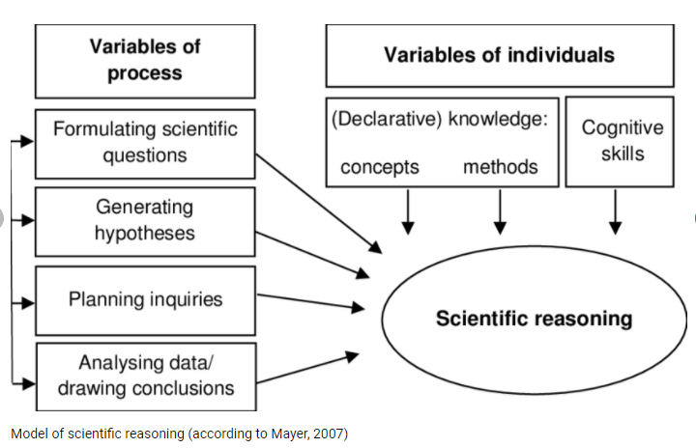
Scientific Reasoning [CO5]

Slide 29
Logical fallacies [CO5]
What is fallacy?
Fallacies are defects that weaken arguments.
First, fallacious arguments are very, very common and can be quite persuasive, at least to the causal reader or listener. You can find dozens of examples of fallacious reasoning in newspapers, advertisements, and other sources.
Second, it is sometimes hard to evaluate whether an argument is fallacious.
An argument might be very weak, somewhat weak, somewhat strong, or very strong. An argument that has several stages or parts might have some strong sections and some weak ones.

Slide 30
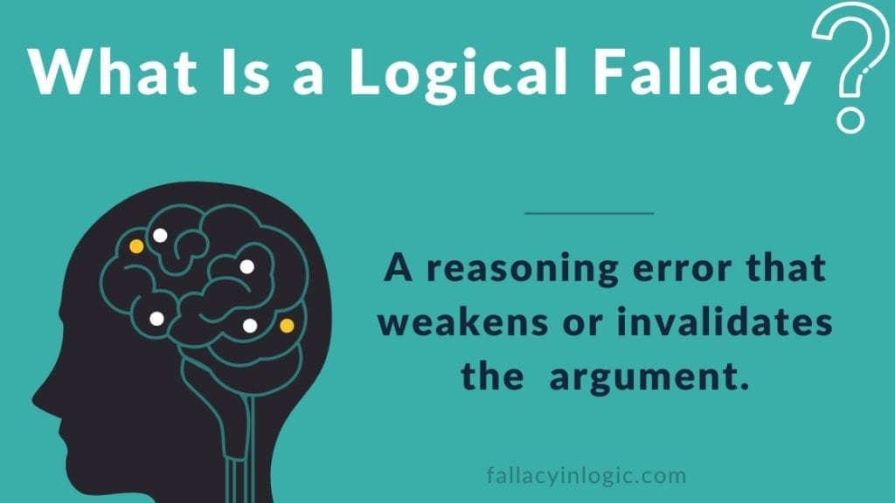
Logical fallacies [CO5]

Slide 31
Logical fallacies [CO5]
What is logical fallacy?
A fallacy is an error of reasoning. These are flawed statements that often sound true.
Logical fallacies are often used to strengthen an argument, but if the reader detects them the argument can backfire, and damage the writer’s credibility.

Slide 32
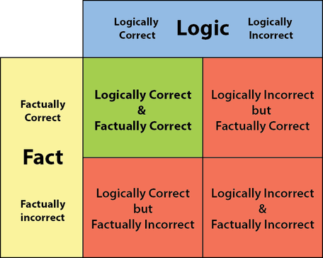
Logical fallacies [CO5]

Slide 33
Propositional logic [CO5]
What is a Proposition?
Propositions are the meanings of statements.
I have no money
I want to play football.
We want to study.
Meanings are the thoughts, concepts, ideas we are trying to convey through speech and writing.

Slide 34
Propositional logic [CO5]
Simple Propositions
Fast foods tend to be unhealthy.
Parakeets are colourful birds.
Simple propositions are grammatically independent expressions of information.

Slide 35
Propositional logic [CO5]
Compound Propositions
If fast foods tend to be unhealthy, then you shouldn't eat them.
Parakeets are colourful birds, and colourful birds are good to have at home.
People are free, if and only if they can choose their actions and there are no forces compelling those actions.

Slide 36
Propositional logic [CO5]
Types of relations between propositions
One proposition is offered in support of another (simple argument).
First proposition expressed the condition under which a second proposition is true (conditional statement).
First sentence offers two proposed alternatives, and a second proposition negates one of these alternatives (disjunctive syllogism).

Slide 37
Probability and judgement [CO5]
Topic Objective:
To understand the concept of probability and judgement. The probability estimate is computed using mathematical equations that manipulate the data to determine the likelihood of an independent event occurring.
Recap:
Revision of propositional logic.

Slide 38
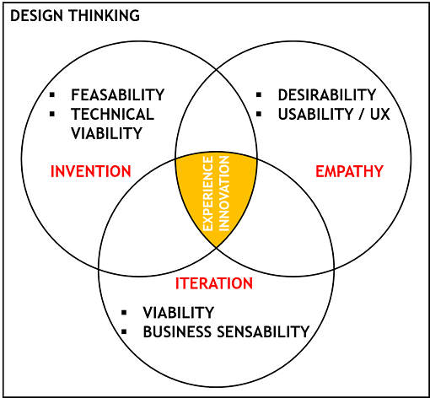
Probability and judgement [CO5]

Slide 39
Probability and judgement [CO5]
Absolute probability judgement
Absolute probability judgement is a technique used in the field of human reliability assessment (HRA), for the purposes of evaluating the probability of a human error occurring throughout the completion of a specific task.
From such analyses measures can then be taken to reduce the likelihood of errors occurring within a system and therefore lead to an improvement in the overall levels of safety.
There exist three primary reasons for conducting an HRA; error identification, error quantification and error reduction.

Slide 40
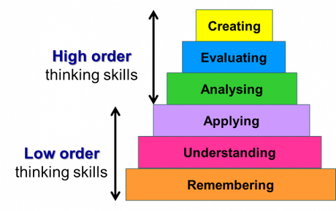
Obstacles to critical thinking [CO5]

Slide 41
Obstacles to critical thinking [CO5]
Barriers to critical thinking
An over-reliance on feelings or emotions.
Self-centred or societal/cultural-centred thinking (conformism, dogma and peer-pressure).
Unconscious bias, or selective perception.
An inability to be receptive to an idea or point of view that differs from your own (close-mindedness).
Unwarranted assumptions or lack of relevant information.
Fear of being wrong (anxious about being taken out of your ‘comfort zone’).
Poor communication skills or apathy.
Lack of personal honesty.

Slide 42
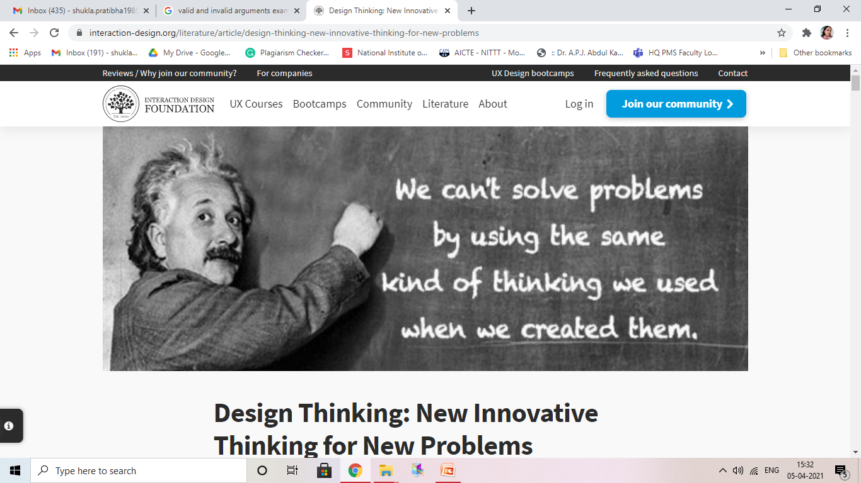
THANK YOU

Slide 43
Faculty Video Links, Youtube & NPTEL Video Links and Online Courses Details
Youtube/other Video Links:
https://www.youtube.com/watch?v=iaiF9cn5I2s
https://www.youtube.com/watch?v=W6CSCuxrheE
https://www.youtube.com/watch?v=SM-OgBxfbi4

Slide 44
Daily Quiz
1. If you are attempting to put your plan into action, what part of the problem-solving process are you working on?
a). Define
b). Prepare
c). Try
d). Reflect
2. The "Try" step means:
Look at the results of your work and think about what you should do to improve it.
a). True
b). False
3. During which step do you see the problem from another person's perspective?
a). Prototype
b). Ideate
c). Empathize
d). Define

Slide 45
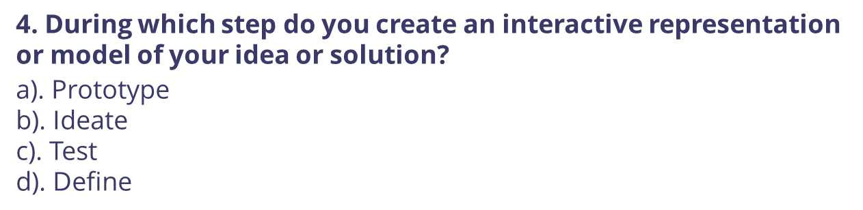
Daily Quiz
5. Which statement about the Prototype step is true?
a). A prototype needs to be perfect
b). You shouldn't worry about how someone might use it
c). The point is to make something that people can test.
d). You shouldn't make it online

Slide 46
Weekly Assignment
1. What are the problems that are associated in designing the user interface?
2. Explain strong and weak arguments.
3. Discuss the term logical fallacies in context of design thinking.
4. Explain the benefits of good design.
5. Write down the various obstacles to critical thinking.

Slide 47
MCQ s
1. Which statement about the Prototype step is true?
a). A prototype needs to be perfect
b). You shouldn't worry about how someone might use it
c). The point is to make something that people can test.
d). You shouldn't make it online
2. During which step do you see the problem from another person's perspective?
a). Prototype
b). Ideate
c). Empathize
d). Define
3. Which is NOT something you do during the Define step of design thinking?
a). Make sure there is only ONE problem
b). Come up with lots of ideas
c). State the problem from the user's point of view
d). Come up with "How might we" questions

Slide 48
MCQ s
4. During which step do you create an interactive representation or model of your idea or solution?
a). Prototype
b). Ideate
c). Test
d). Define
5. Which is NOT true about the Test step?
a). It is an opportunity to make your idea better.
b). You should come up with new ideas during the Test step
c). You should assume that you will make mistakes.
d). You only want positive or "good job" feedback
6. During which stage would you: Want to try to "think outside of the box".
a). Prototype
b). Define
c). Ideate
d). Empathize

Slide 49
MCQ s
7. Which stage would you consider to be an experimental phase where you are trying out solutions you previously brainstormed?
a). Prototype
b). Define
c). Ideate
d). Test
8. Which is NOT something you do for the ideate step of design thinking? a). Decide if the idea is good or not before sharing it
b). Look at your "How might we" question a lot
c). Come up with as many ideas as possible
d). Share any idea that matches the problem

Slide 50
Old Question Papers
NA

Slide 51
Expected Questions for University Exam
1. Explain the concept of propositional logic.
2. Explain strong and weak arguments.
3. Discuss the term logical fallacies in context of design thinking.
4. Explain the benefits of good design.
5. Write down the various obstacles to critical thinking.
6. Differentiate between valid and invalid arguments.
7. What do you understand by the term deductive argument?
8. Explain the importance of probability in design thinking.

Slide 52
Summary
After the completion of the unit, students should understand the concepts of various truth and logic conditions, valid and invalid arguments, strong and weak arguments, logical reasoning, scientific reasoning, propositional logic and probability.

Slide 53
Thank You

